Slide 1
Clinic
Management
System
DR:Essam Eliwa Mariam Hesham – Sandra Faris Nour Ahmed – Samiha Hesham

Slide 2
Dr Ahmed Ghoniem clinic

Slide 3
Agenda
01
Introduction
The main purpose of this project ,The scope , The overview and the Business Context .
02
General description
Product Functions, Product context , Similar System Information , User Characteristics and User Problem Statement
03
System Requirements
Functional Requirements , Non-Functional requirements and Interface requirements
04
Diagrams
Use-case diagram , Context diagram, Block diagram , Class diagram and ER diagram, Database Diagram.
05
Operational Scenarios
Login and Registration System , Appointment System , Chatting System , Operation System and Administrator System
06
Human Interface Design
User Interface, Screen Images
07
Requirements Matrix
08
References

Slide 4

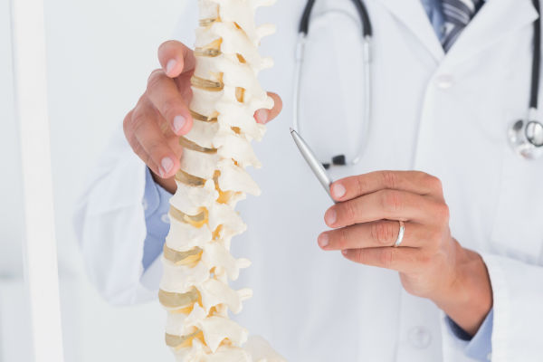
Overview
INTRODUCTION
The proposed software system will be made for a knee and orthopedic clinic. The system should be used by the clinic staff with all their roles. Also by the patients that will interact with the clinic. The systems would make appointments to be easy for simple users. Also the system will manage the clinic’s users , appointments, operations, notifications and reports.
Scope
The scope of this document is to talk about the technicality of this software system . It will be an application for Dr Ahmed Ghoniem clinic. This system will be designed to help the clinic to have an easier system of appointment. A full database instead of paper usage and more faster way to manage the appointments , generating reports and adding operations if necessary. More over, the system is designed to help the doctors to know the medical history of the patients and to access their reports easily .The system must be build in incremental model and agile model.

Slide 5
Intended audience Mainly we have five stakeholders:
Abbreviations
ER=Entity Relationship diagram
Receptionists
Tb=table
SMS = Short Message Service
Doctor
Assistants
Online
Doctor
Admin
Patients
Rtb=relation table
API=application program interface

Slide 6
Project
Overview
The outcome of this project is a Clinic software product that is used to assist patients in booking appointments effortlessly. This software collects data about the patients and their medical history, which helps the Doctor to get a better view of the Patients' case and view their medical history easily any time necessary. Therefore, offering accurate Diagnosis in less time and with less confusion. Moreover, this product shall offer better communication with the Dr and his Patients. The Doctor can write reports for his patients and keep them updated. On the other hand, Patients also have the ability to reach out to the Doctor's assistant using a chatting system, learning more about their case and the operations scheduled, if any.

Slide 7
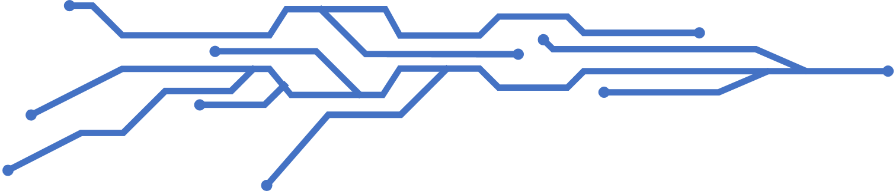
Project Scope
The project's target is to help Patients book appointments and assist the Dr to view his patients' data effortlessly. This target shall be reached using certain methods. These methods include offering the patient an easy way to fill his information and book his appointments in any time suitable for him without reaching out to receptionists. On the other hand, the receptionists shall be automatically notified when a patient books an appointment. Moreover the patients' data, including their medical history, shall be saved for the Dr to view easily any time. API tools shall also be used to offer a chatting system for the Patients and the Doctor's assistant to communicate. By successfully building these methods and making them function well, there shall be no more confusion with retrieving Patients' data and booking appointments. The patients and the Dr shall be updated with any new progress shortly and effortlessly.

Slide 8
Goals and objectives
The Patients shall be able to book appointments effortlessly
.
The Doctor shall be able to add an operation
.
Receptionists and the Doctor shall be able to view appointments
The Doctor's assistant shall be able to schedule operations and contact patient
.
The Patients shall be able to contact the Doctor's assistant through a chatting system.
.
The admin shall be able to add staff, view appointments and manage everything concerning the system.
The Doctor shall be able to view Patients' medical history
The Patients and The Staff shall be able to login into the system, if verified, and shall be forwarded to their main pages
.
The Doctor shall be able to add Reports concerning his Patients' cases
.
The Patients shall be able to register into the system.

Slide 9
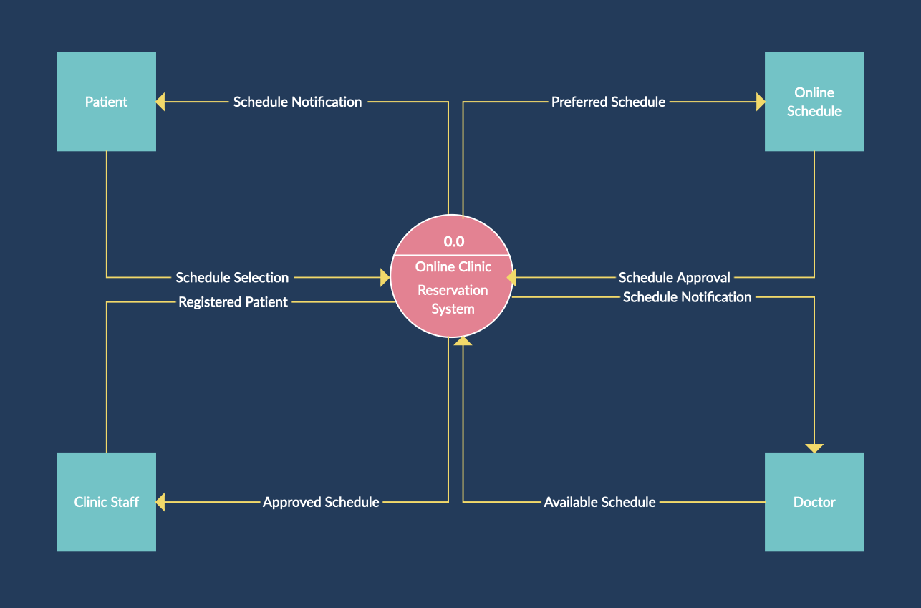
Context Diagram
Context viewpoint

Slide 10
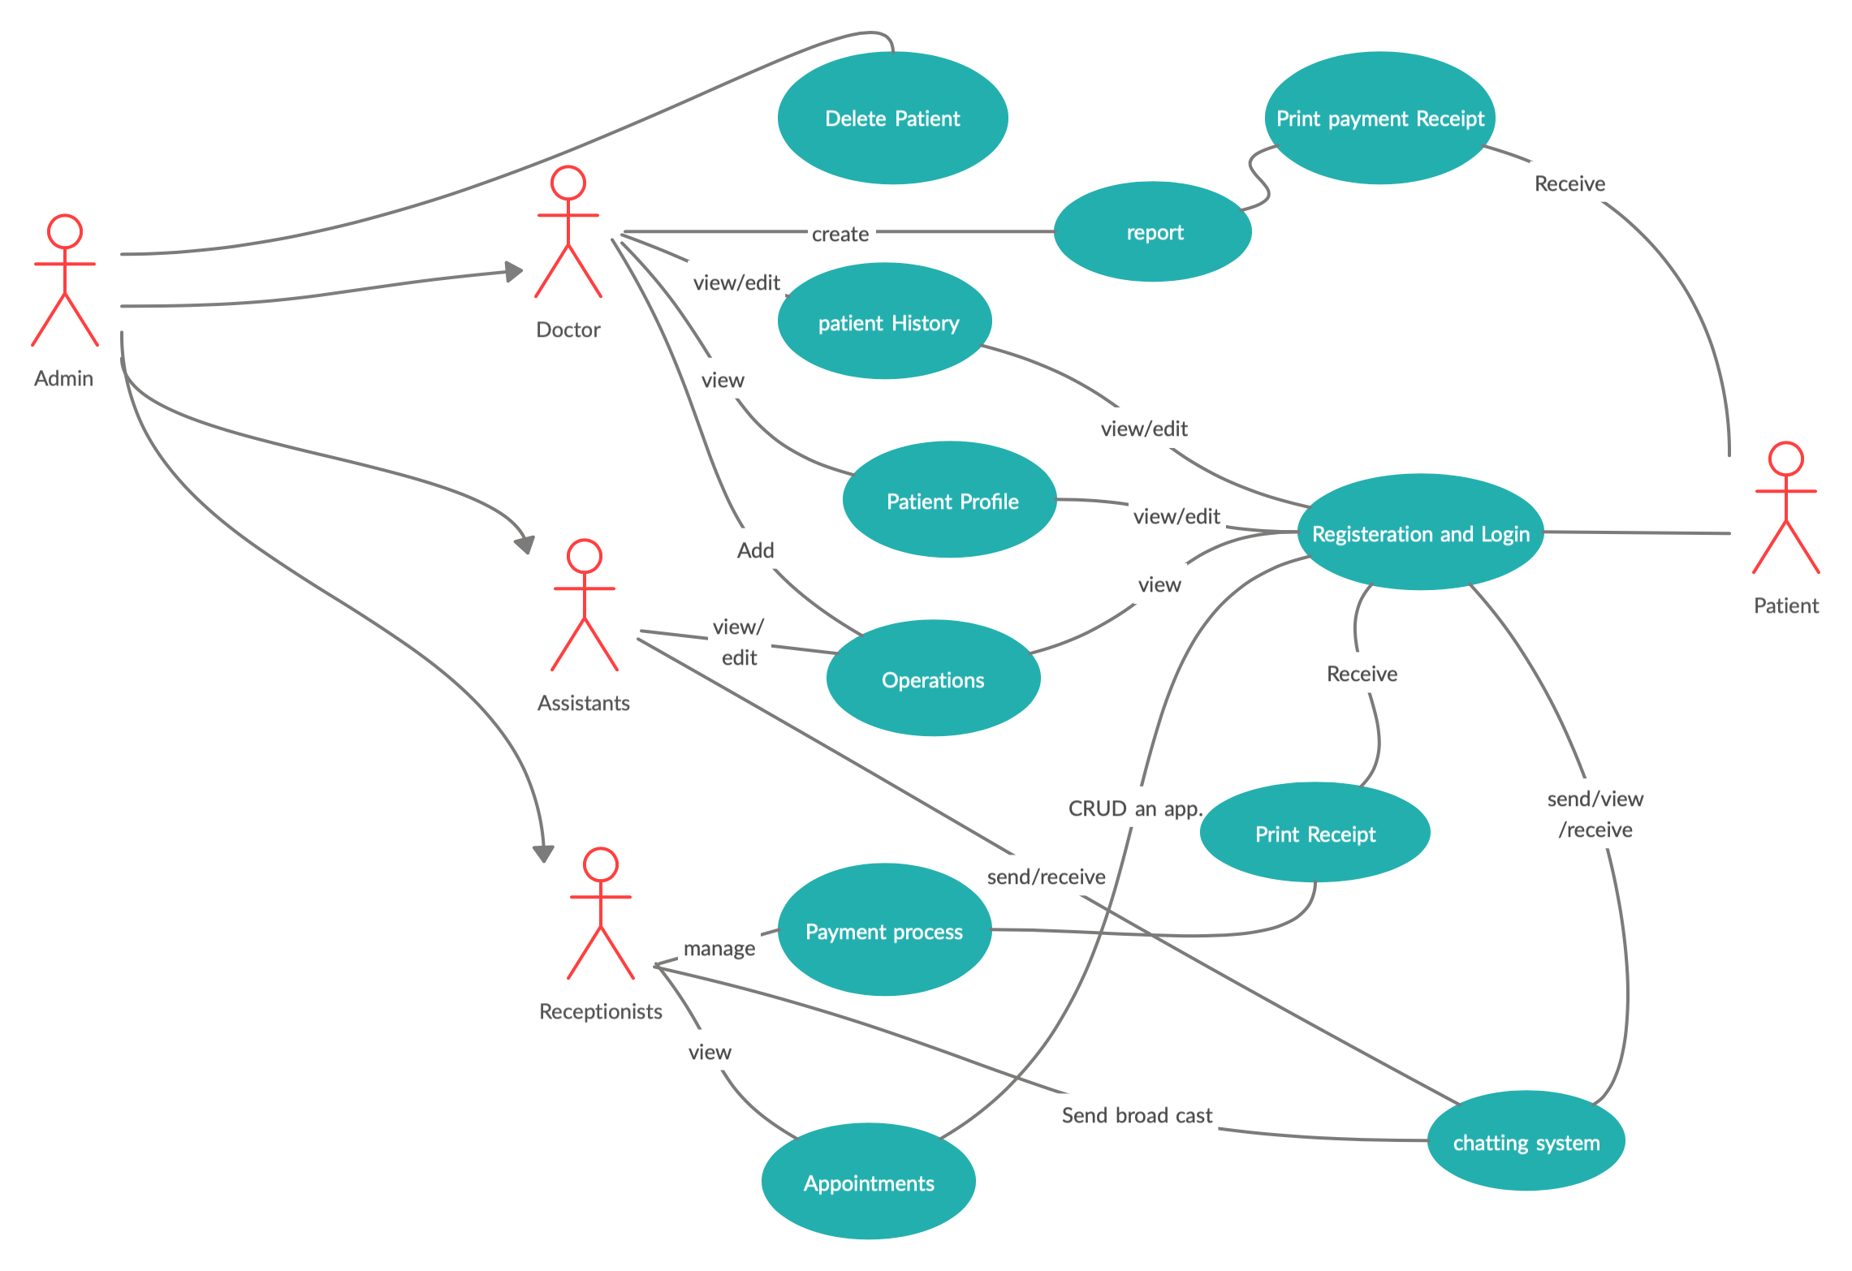
Use-Case scenario
Context viewpoint

Slide 11
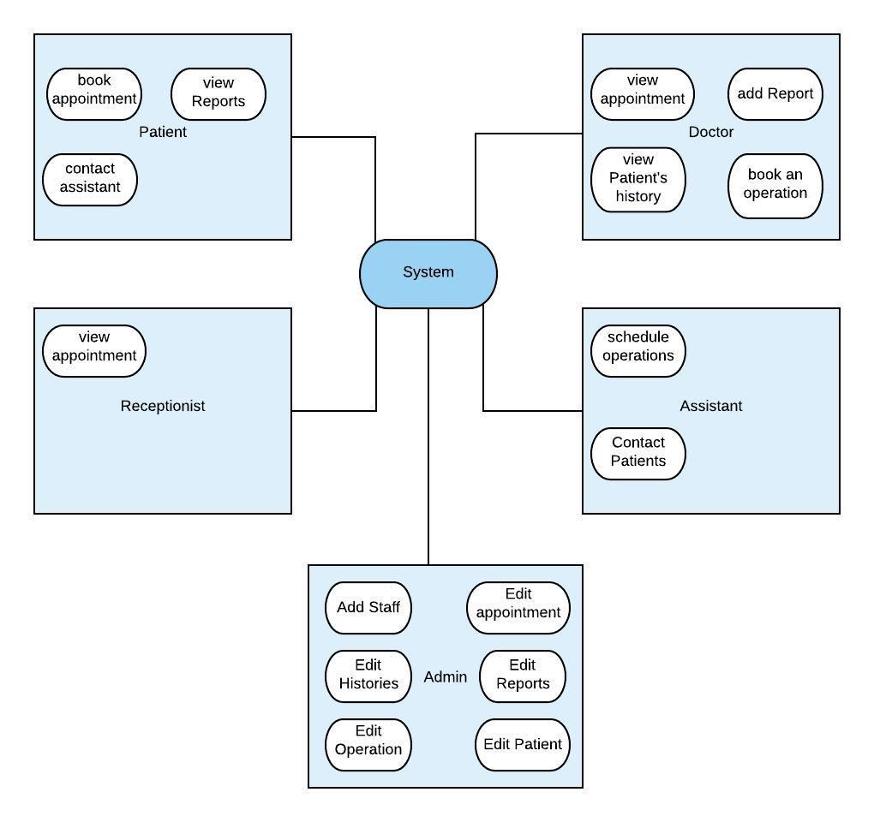
Logical viewpoint Our system is divided into five models
Receptionists: They are mainly responsible for viewing the appointments
Admin: The Admin is the owner of the system. He has the ability to add Staff and view their data, in addition to viewing everything in the system
Doctor: The system gives the Dr. a lot of privileges, such as viewing appointments, adding reports, viewing Patients’ medical history and view operations
Patients: The system gives a lot of privileges to Patients too. Some of the functionalities that the sys-tem provides to Patients include, booking appointments, viewing reports ,and contacting the Doctor’s assistant
Assistants: The assistant’s main job is to manage operations and contacting Patients through a chatting system

Slide 12
MVC Architecture
Our system is designed using the MVC architecture, which consists of three partitions: Model (Data access layer), View (Presentation Layer), and Controller (Controlling Layer)
1. Model Layer: Contains only the pure application data, it contains no logic describing how to present the data to a user. By means, it contains the functions which interact directly with the database . Example: •CRUD: all the functions that are implemented for our users and objects (Create, Read, Update , Delete) deal with the model layer as our functions interact directly with the database.
Model
2. View Layer: presents the model’s data to the user. The view knows how to access the model’s data , but it does not know what this data means or what the user can do to manipulate it. Simply, the view layer is concerned with what the users see on their screens. Example: •Doctor’s dashboard: it is the page that appears for the Doctor when he logs into the system.
viewer
3. Controller Layer: It is a mid layer. It exists between the view and the model. It listens to events triggered by the view and executes the appropriate reaction to these events. In most cases, the reaction is to call a method on the model. Example: Login: by getting the data entered by the user and checking into the database if the user exists or if the data are valid
controller

Slide 13
Design Rationale
MVC is a quite useful architecture to use for our system, as the system is huge. It will help us develop our system easily and in a simple way. Moreover, it helps us update our system easily if needed, making our system more flexible and reliable. It also makes it easier for multiple developers to work together, which is a great advantage in our case

Slide 14
Patterns use viewpoint
MVC design pattern
Clinic management system is build on MVC form. MVC is the separation of Model, View and Controller classes. Main advantage of MVC architecture is differentiating the layers of a project in Model , View and Controller for the Re-usability of code and better maintenance. MVC is applied in most of the tables in our project. Examples: •Notification system •patients system •Appointment •Reports

Slide 15
Singleton Design Pattern
Patterns use viewpoint
Singleton design pattern is used to allow access to one and only one instance of a particular class. It provide global access the that single instance from anywhere. In our project we used singleton in connection to the database class which is the database helper class, so a single connection is made to the database by each user
Observer Design Pattern
The Observer Design Pattern is used in the application for the notifications feature due to that we notify indifferent formats emails and SMS
Facade Design Pattern
Facade pattern creates an easy use interface by hiding multiple interfaces in one class. we will use façade on all APIs used to hide the complexity of the code

Slide 16
Composition viewpoint
Provide a decomposition of the subsystems in the architectural design. Supplement with text as needed. provide subsystem model, package diagrams, generalization hierarchy diagram(s) (if any), aggregation hierarchy diagram(s) (if any).

Slide 17
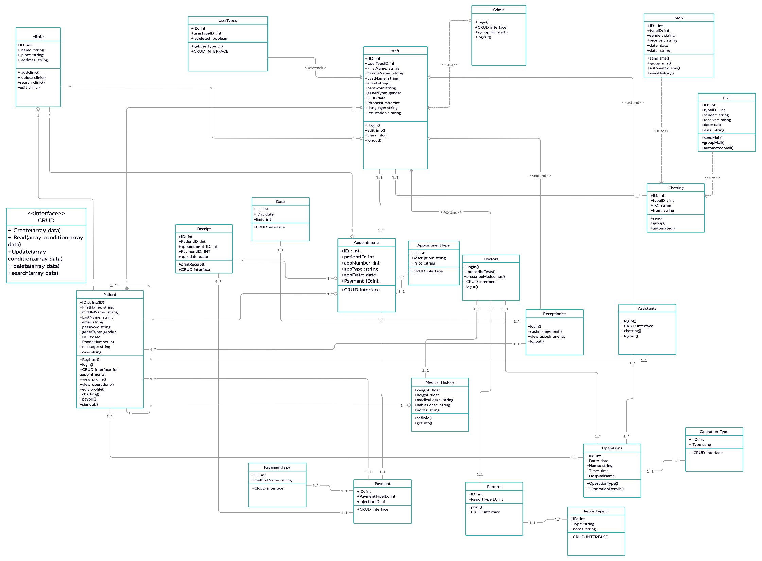
Class Diagram
Structure viewpoint
CRUD interface: This will contain the functions which draws the Forms and tables to contain the data of the users for viewing ,searching,inserting , deleting and editing.
Login: In this part the files are meant to make the validations and verification on all the data inserted for protection and insurance during login.

Slide 18
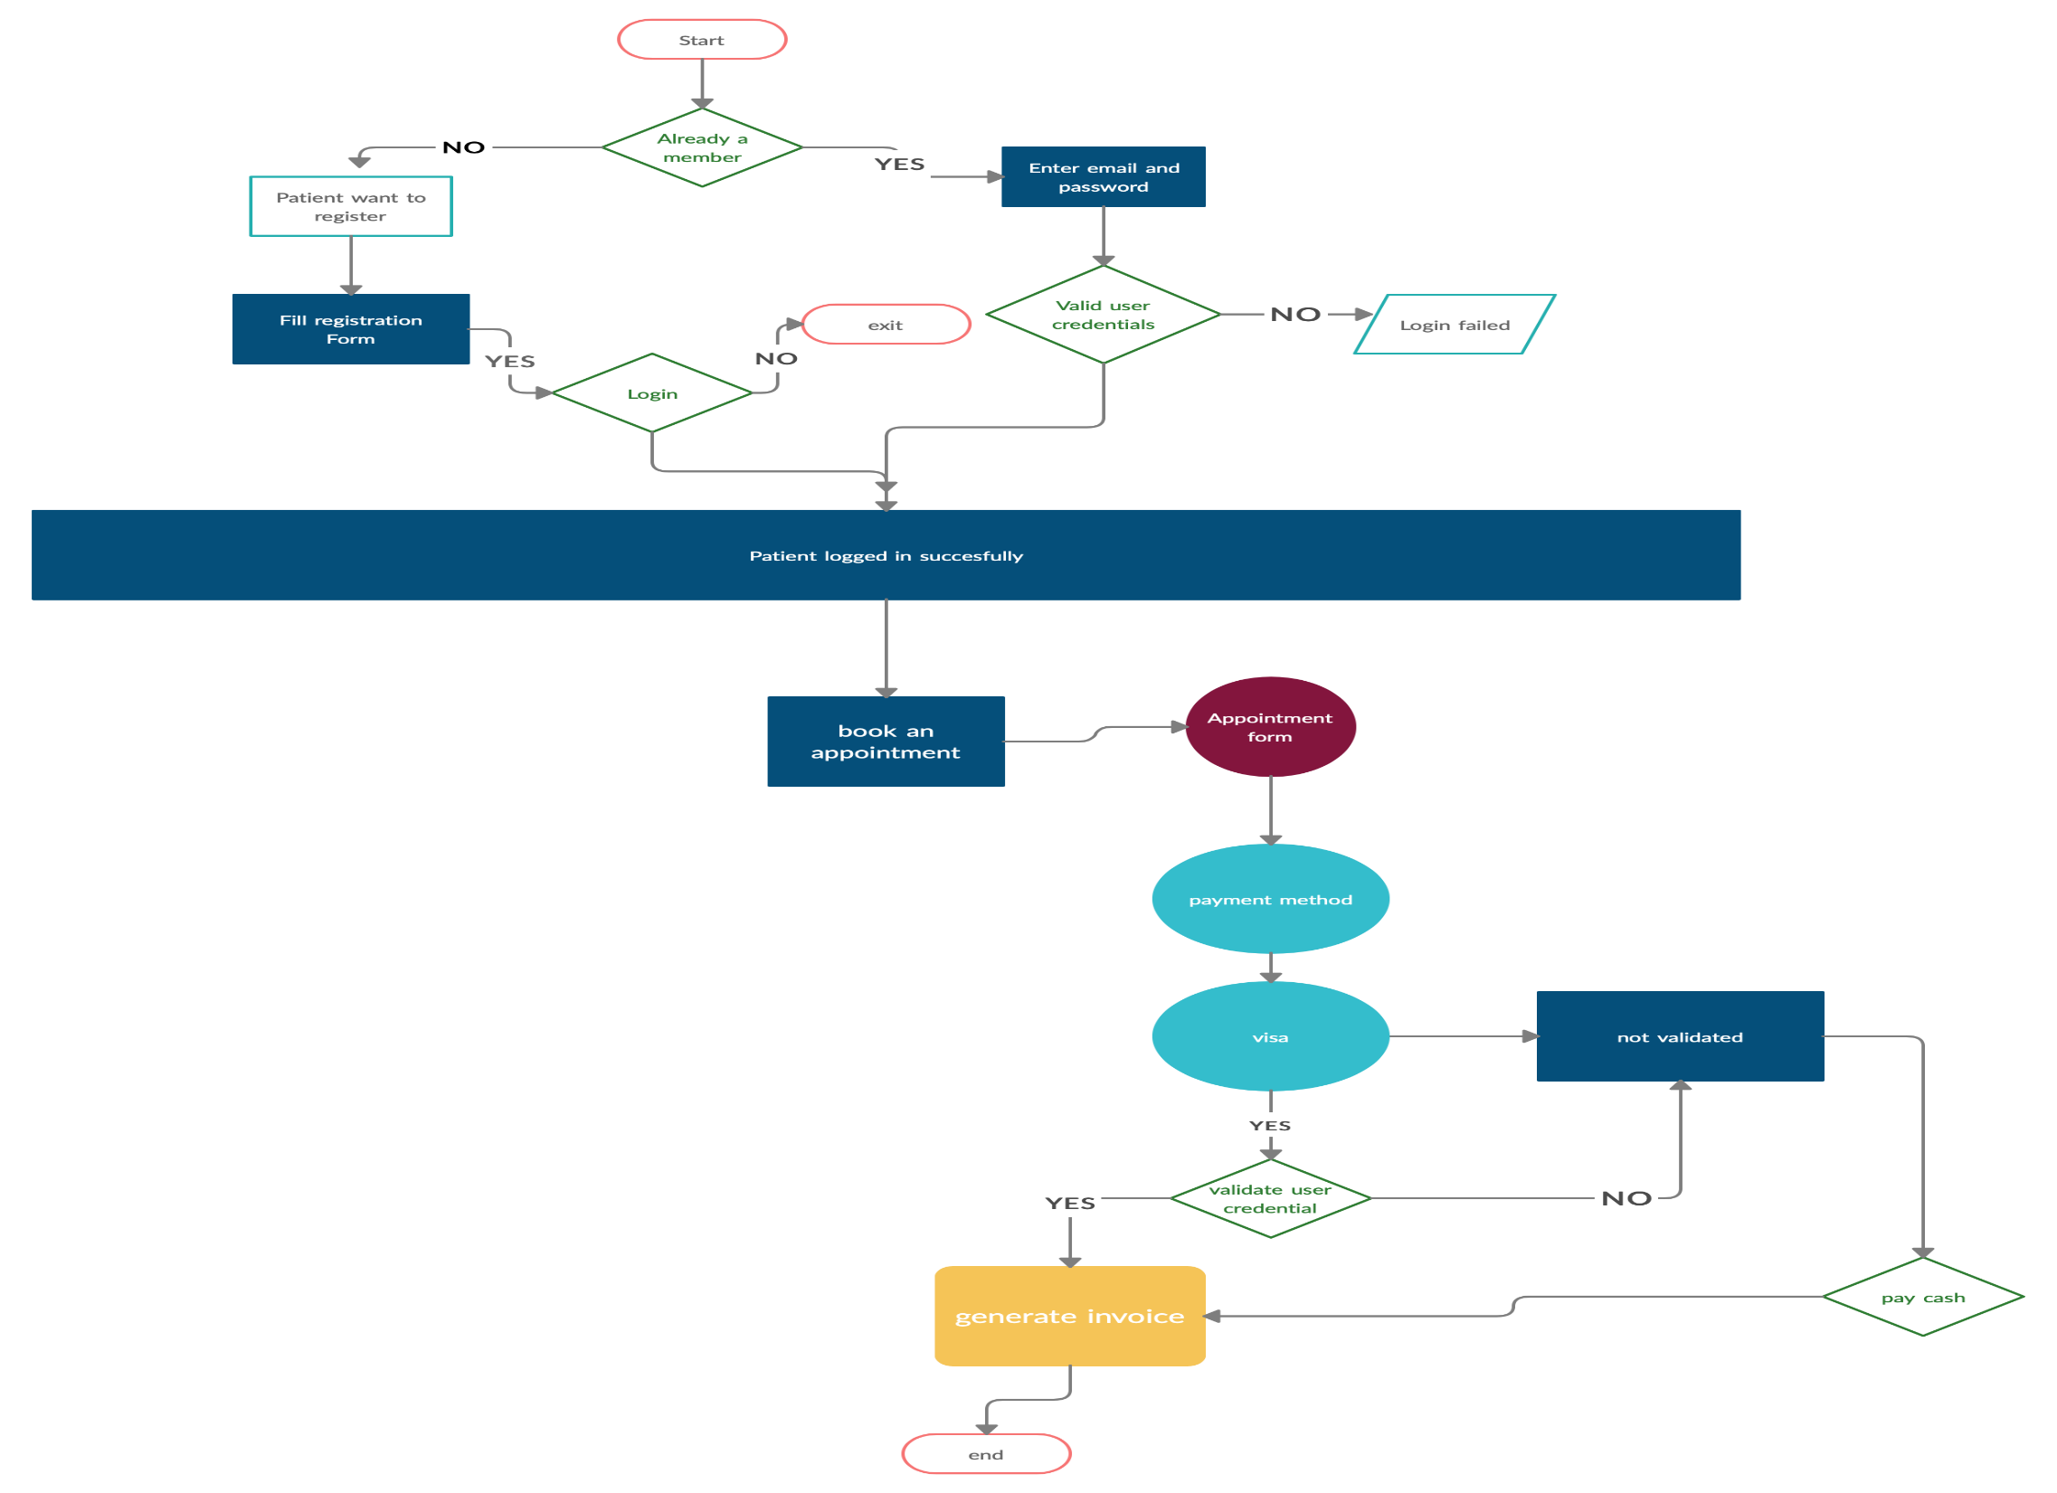
Process Architecture
Structure viewpoint
Structure viewpoint

Slide 19
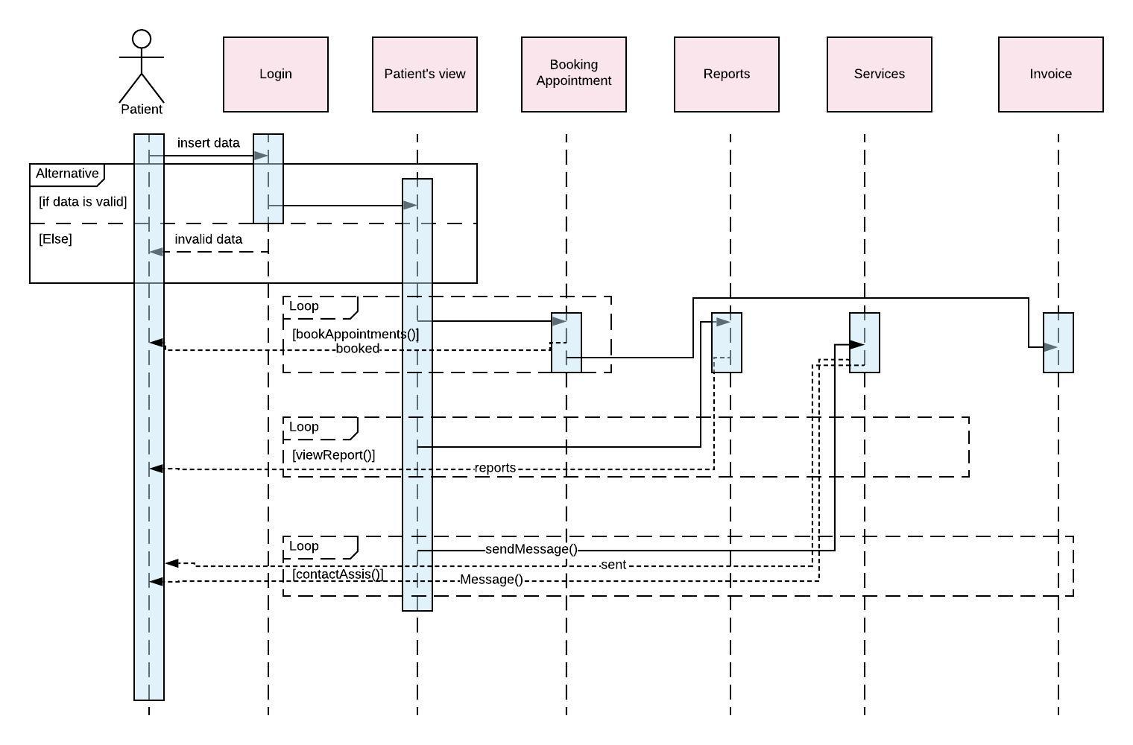
Interaction viewpoint
Patterns use viewpoint
Patient
The Patients’ sequence diagram shows the sequence of events that happen and appear to the Patient , once he logs into the system. If the Patient managed to successfully log into the system, the Patient’s main page pops up, which has many options for the patient. If the Patient chose to book an appointment, the appointment page appears to him, so he can start booking. Once he’s done booking, an invoice page appears to him. The Patient can also view Reports written to him by the Doctor from his main page. Once he chooses this option, a page appears with all his Reports. Moreover, the Patient can contact the assistant through the Services page, and be informed when the assistant replies to his message

Slide 20
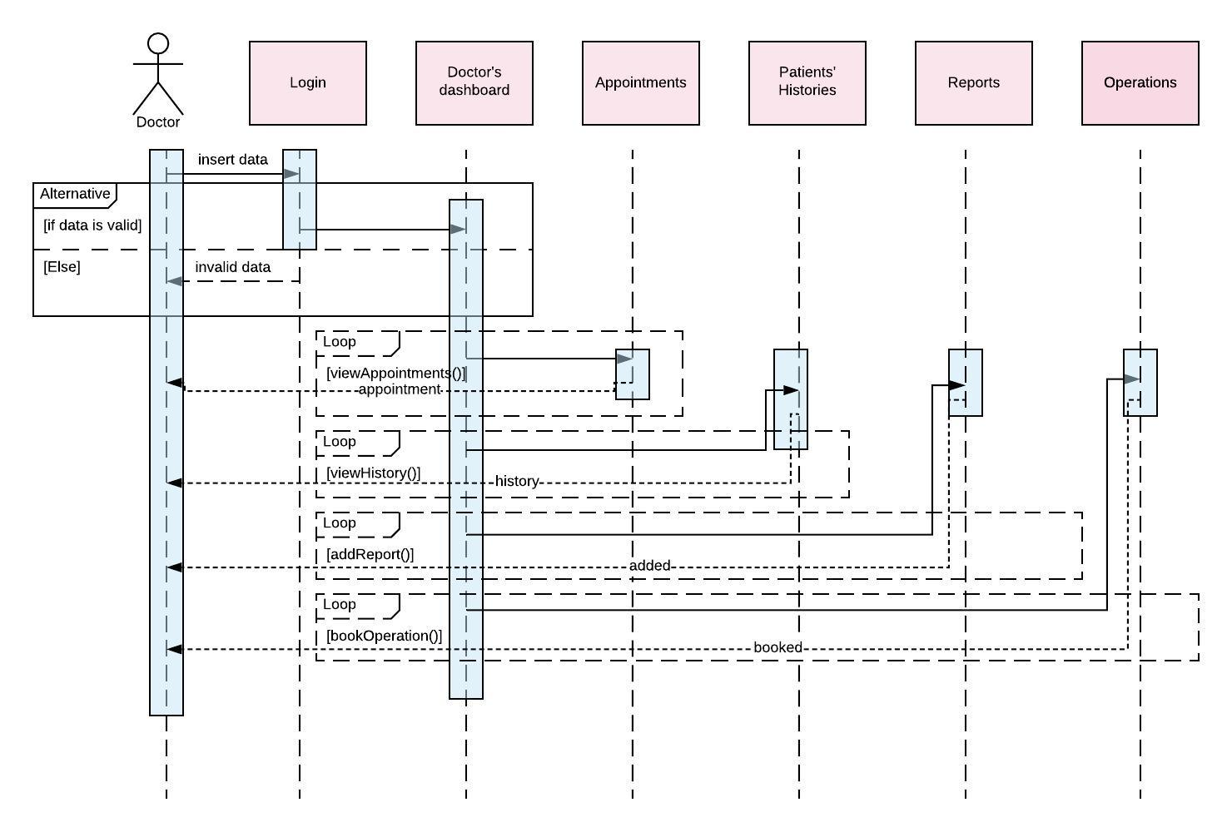
Interaction viewpoint
Doctor
The Doctor’s sequence diagram shows the sequence of events that happen and appear to The Doctor , once he logs into the system successfully. The first things that appears to the Doctor is that Doctor’s dashboard that, like the Patients’, has various alternative pages for the Doctor to choose from. If the Doctor wished to view appointments, the appointments page, which has all the appointment’s for the day, will pop up to him. The Doctor can also open the Reports’ page, which will allow him to add a Report for any Patient he chooses. Moreover, he can view Patients’ histories and book operations , leading him to the pages required for each of them

Slide 21
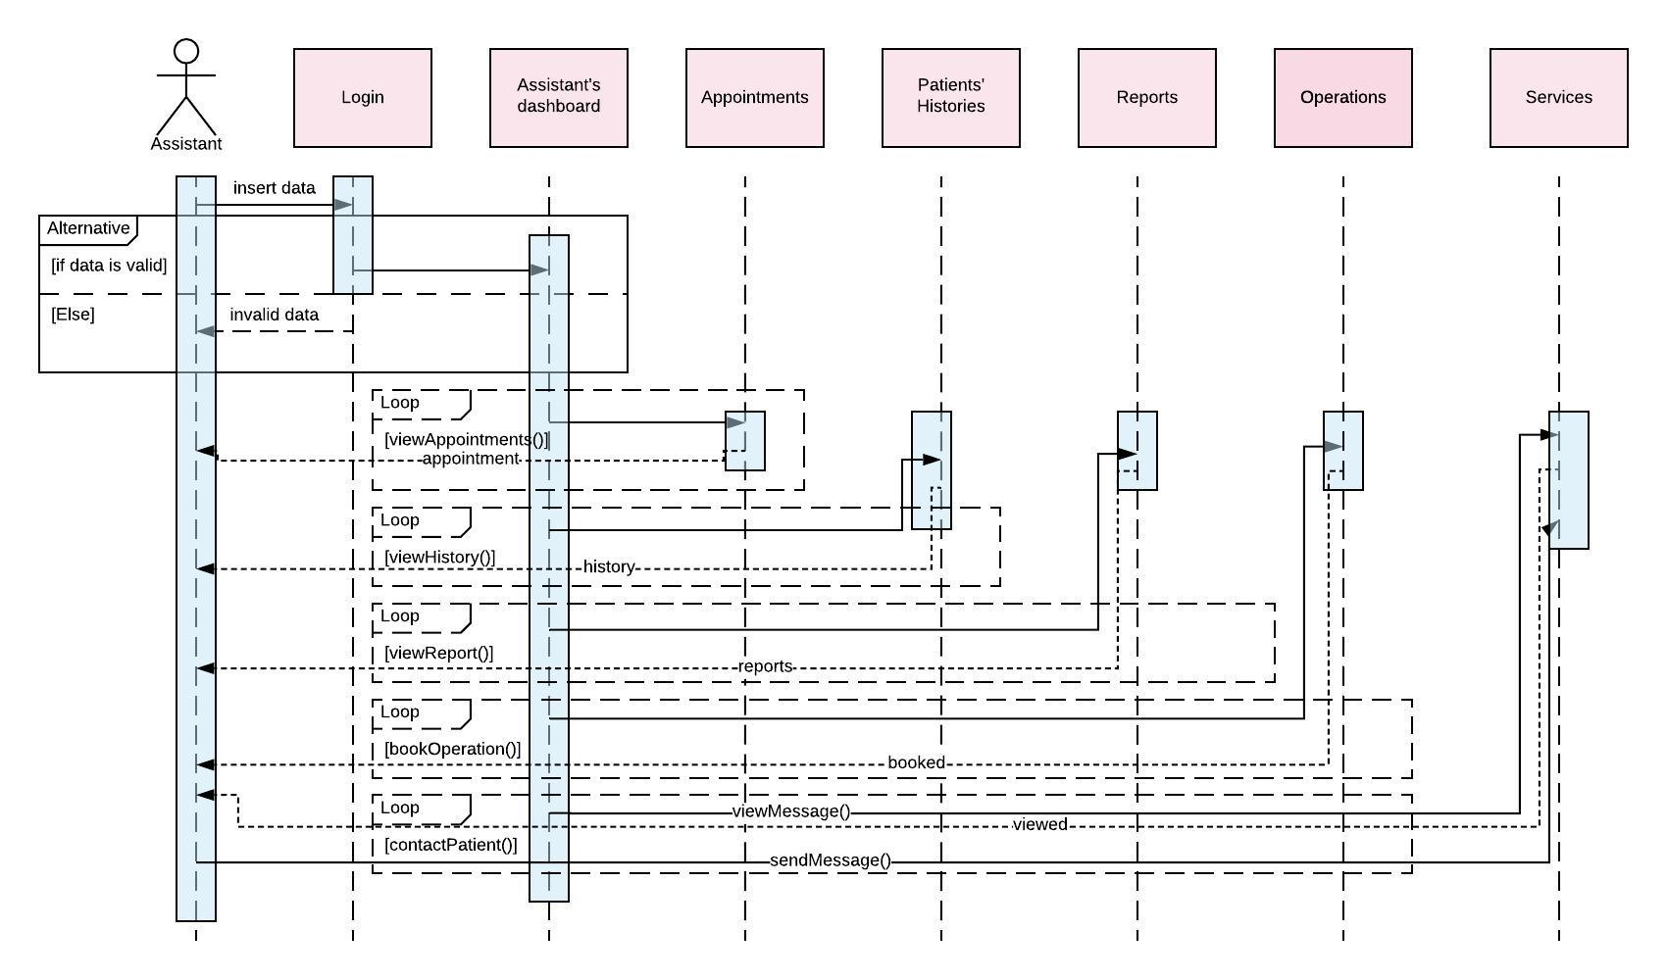
Interaction viewpoint
Assistant
The Assistant’s sequence diagram shows the sequence of events that happen and appear to the Assistant, once he logs into the system successfully. The first things that appears to the Assistant is the Assistant’s dashboard that, gives him the right to view the appointments, the histories of the Patients ,and the Reports written by the Doctor. The Assistant can also chat with Patients through the chatting system and reply to their messages. Moreover, he can book operations for the Patients. For each of these options, appears a page for the Assistant work on.

Slide 22
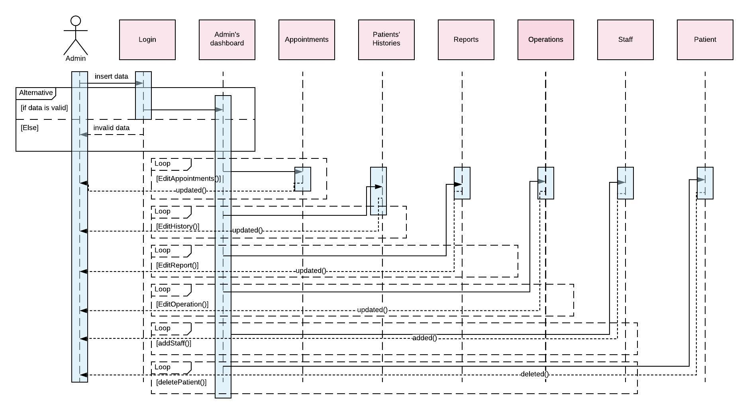
Interaction viewpoint
Admin
The Admin’s sequence diagram shows the sequence of events that happen and appear to the Admin , once he logs into the system successfully. The Admin’s dashboard appears once he logs in. The Admin has the privilege of updating everything in the system including, Appointments, Patients histories , Reports , and Operations. Moreover, he has the ability to add Staff and delete Patients.

Slide 23
Interaction viewpoint
Receptionist
The Receptionists’ sequence diagram shows the sequence of events that happen and appear to the Receptionists, once he logs into the system successfully. The Receptionist’s dashboard pops up, which has less options than the rest. The Receptionists’ can only view appointments and view invoices, so they can print them to the Patients

Slide 24
Data Dictionary
Data Design
•Rtb option user type: the relation between the options the user types which is mainly the staff as Admin,doctor,assistant,receptionist .•Rtb Payment : the table that contains the relations between the Payment Method ID and the description, where it saves the options ID required to be shown when selecting any kind of payment according to the appointment type. •Rtb appointments: the relation between the clinic ID from class clinics that is chosen and the patient’s specific time slot that is booked. •Rtb patient’s history: the relation between the patients and the doctor as the doctor is allowed to view every patients history to precisely wrote the report needed for this specific case. •Tb clinics: stores the description and the id of each clinic branch. •Tb option payment values: the table that carries the values that each user has paid by a certain payment method. •Tb injections: saves the description and the price of the injection the doctor recommended to the patient. •Tb appointments: the appointments that happened and its amount and category each appointment also stores the day and the patient’s id. •Tb day limit: that table that stores the day of appointments and the maximum limit of appointments for that specific day because it is dynamic and depends on the type of appointment that is reserved.

Slide 25
Data Dictionary
Data Design
•Tb staff: the email and hashed password for each user signed up on the system and his/her own profile details .•tb patients: storing the data of the patients while registering into the system. •Rtb operations: the table that contains the relation between the patient and the assistant that the assistant has the ability to add operations if needed to this specific patient •Rtb operations type: the table that contains the relation between reports and operations that knows from the reports if the doctor added an operation to this patient or not. •Rtb reports: the table that contains relation between the patient and the doctor as the doctor has the ability to generate a report to each patient with specific description according to his/her illness. •Tb reports: stores the date the report generated at, comments and the patient’s ID .•Tb message: the email subject and content that system can send to clients .•Tb message type: determine either the message is via mail or SMS .•Tb user type: all the staff types on the system and their IDs.

Slide 26
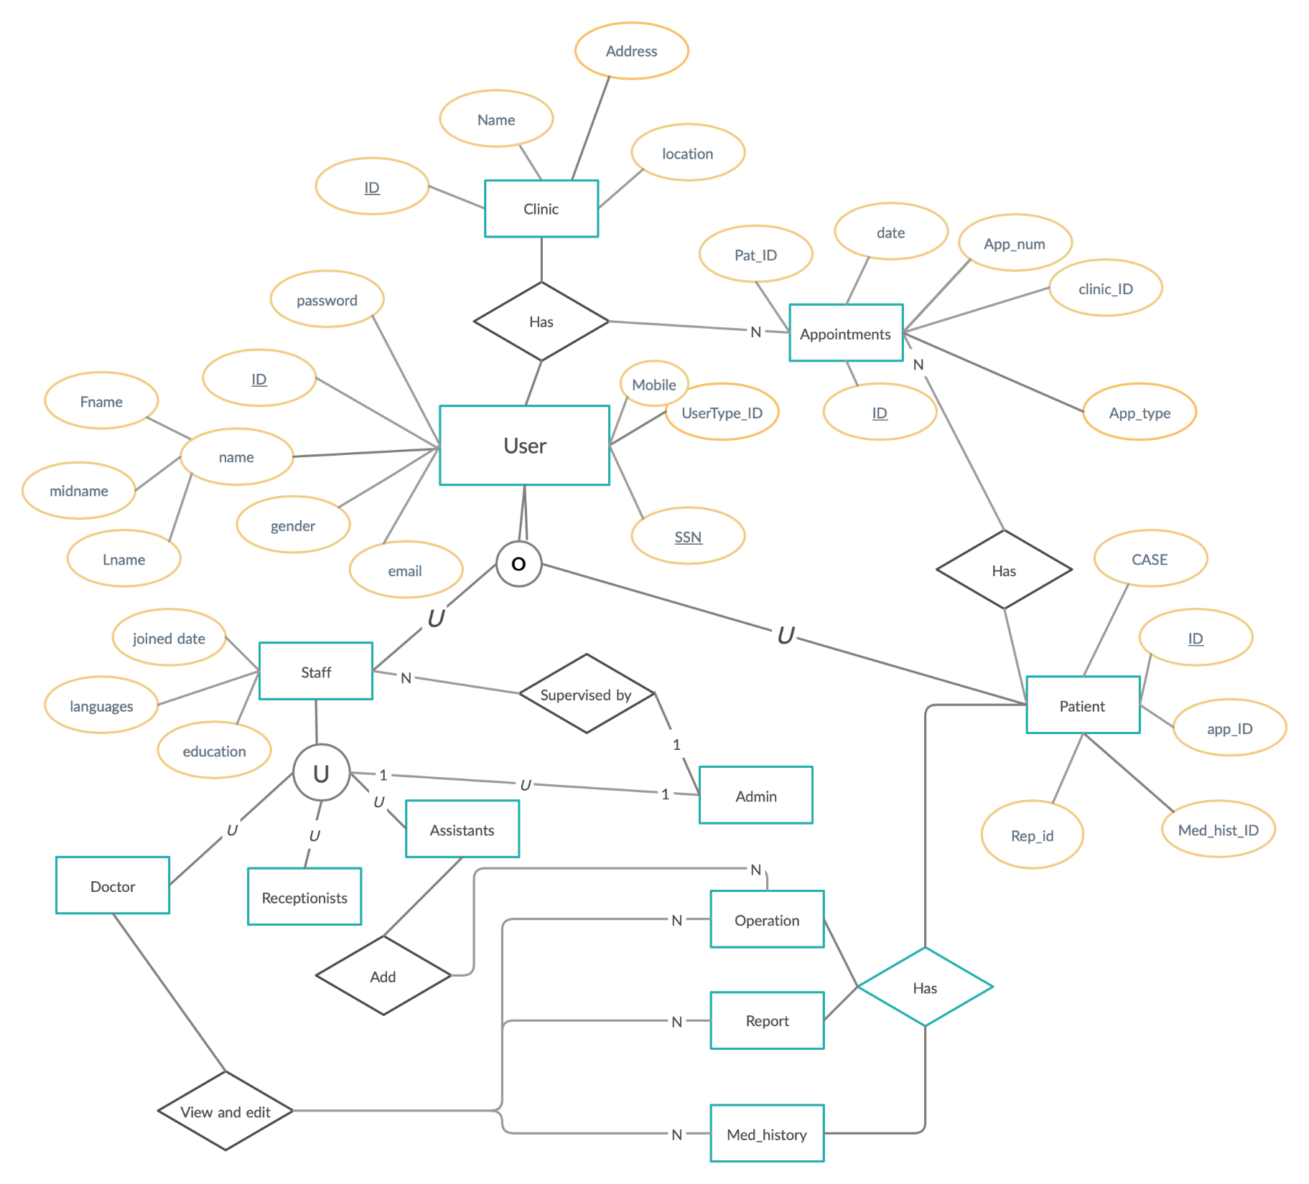
ER Diagram
Database design description

Slide 27
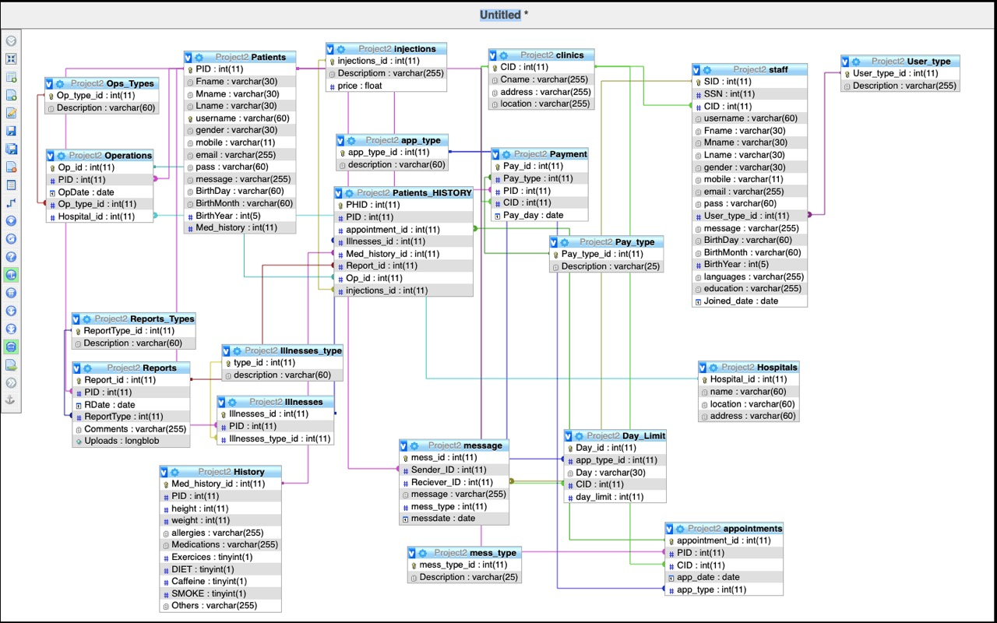
Database Schema
Database design description

Slide 28
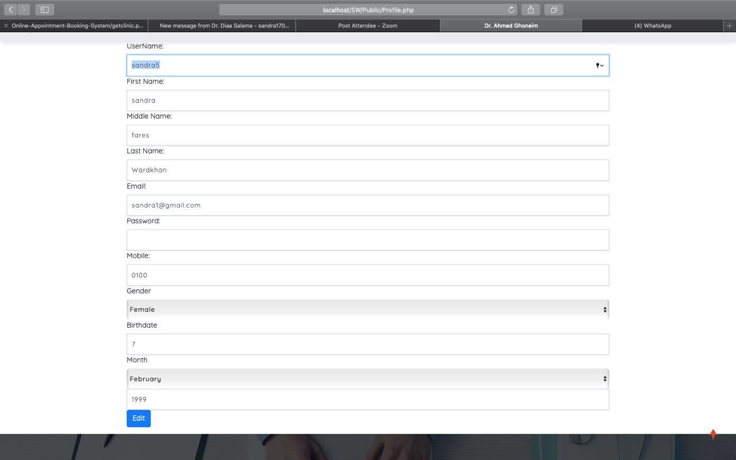
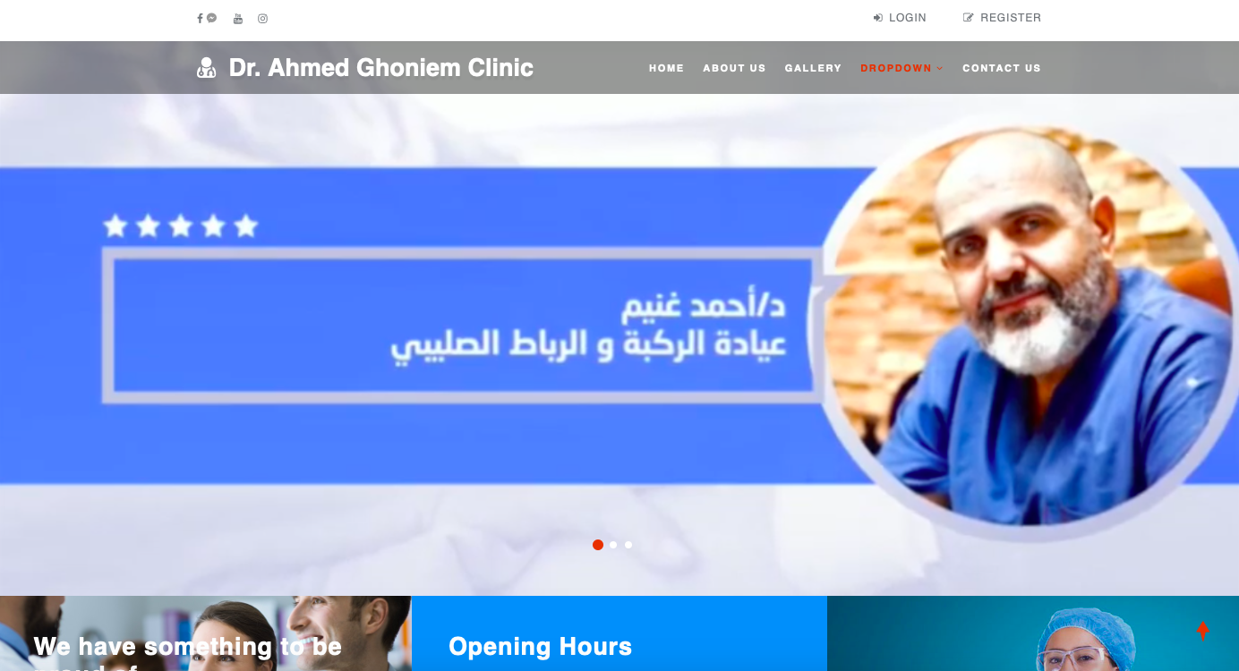
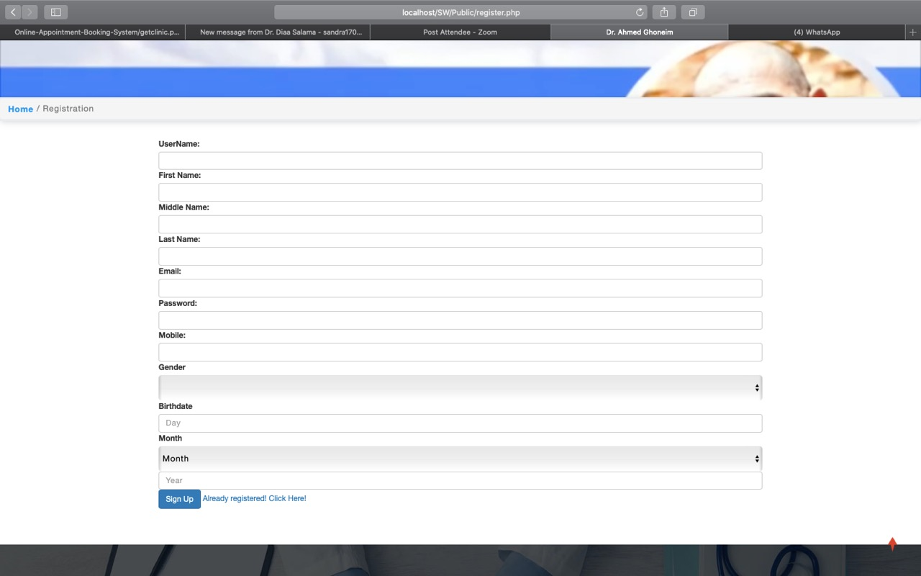
Human Interface Design
User Interface
The proposed project allows the user to create an account. The system will allow the user to sign in with his account. The patient will choose which clinic branch he will book an appointment at. The system allows the clinic to have accounts for every patient to be easier to contact with them. Also from the staff’ side it will help the doctor to know the medical history and generate report to each patient to follow up with them.

Slide 29
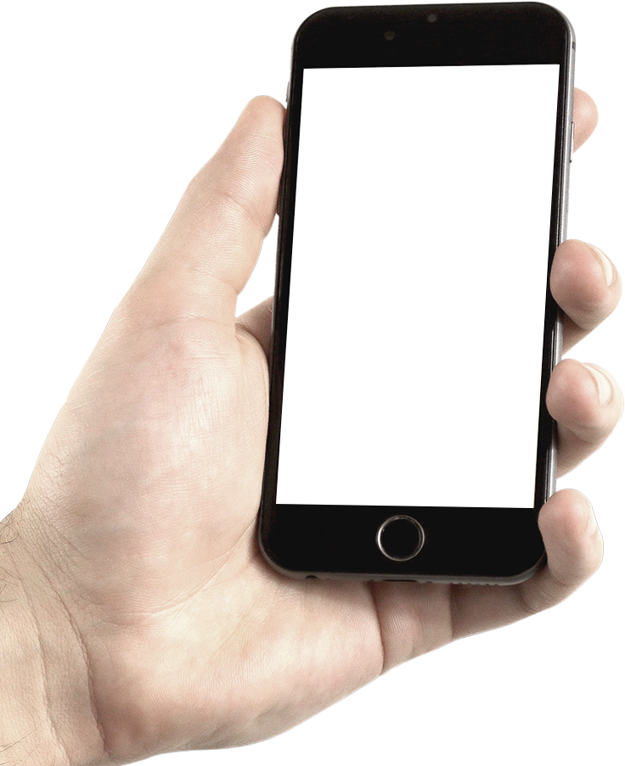
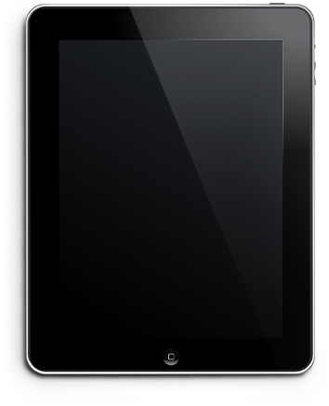
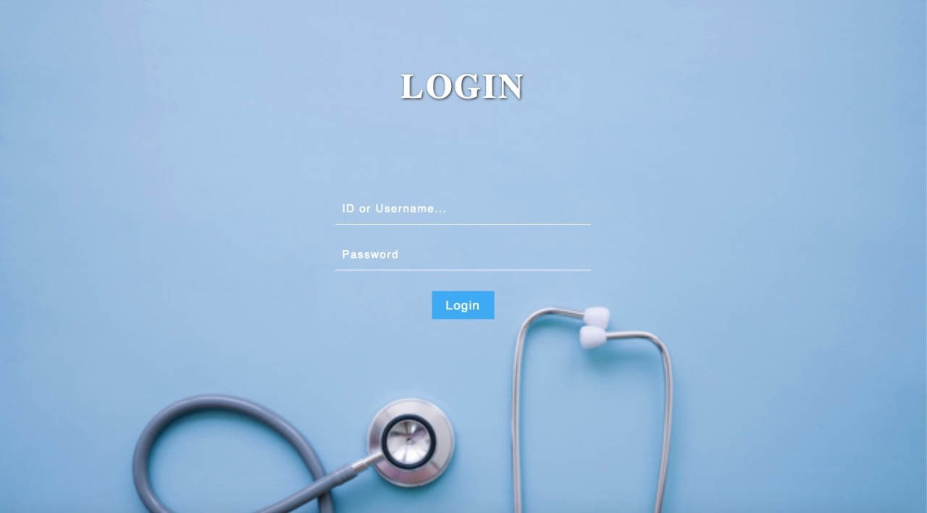
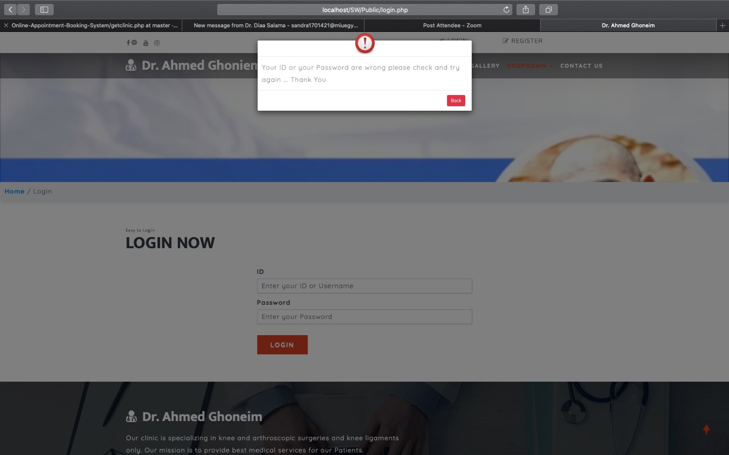
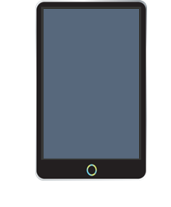
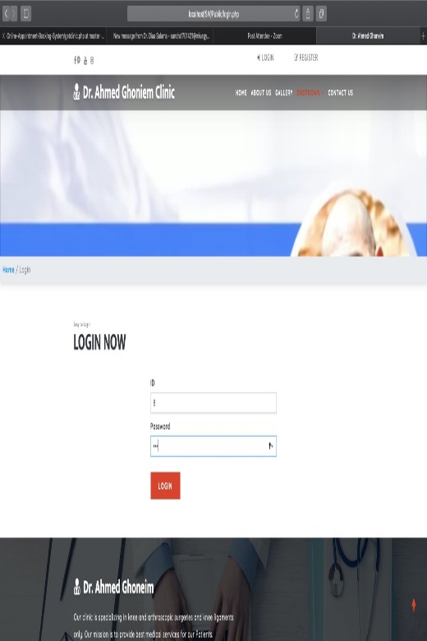
Screen Images
Staff’s Login
Patient's Login
Patient's Login

Slide 30
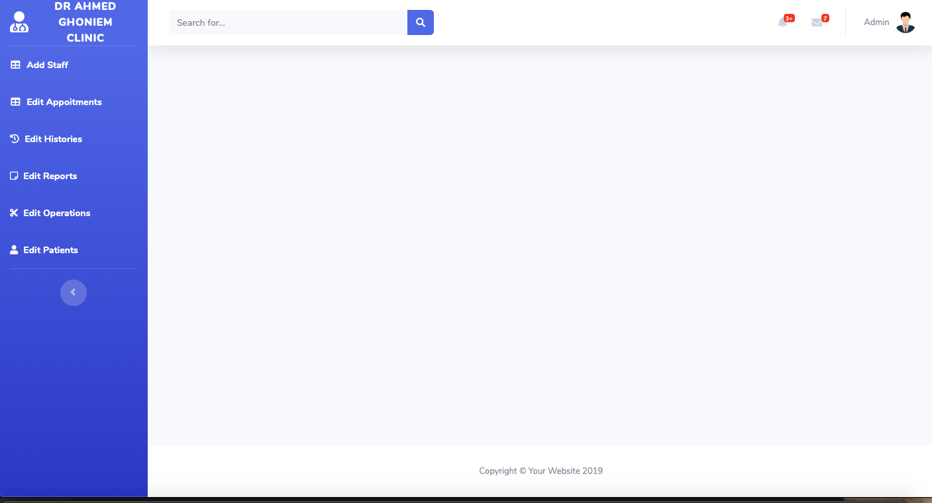
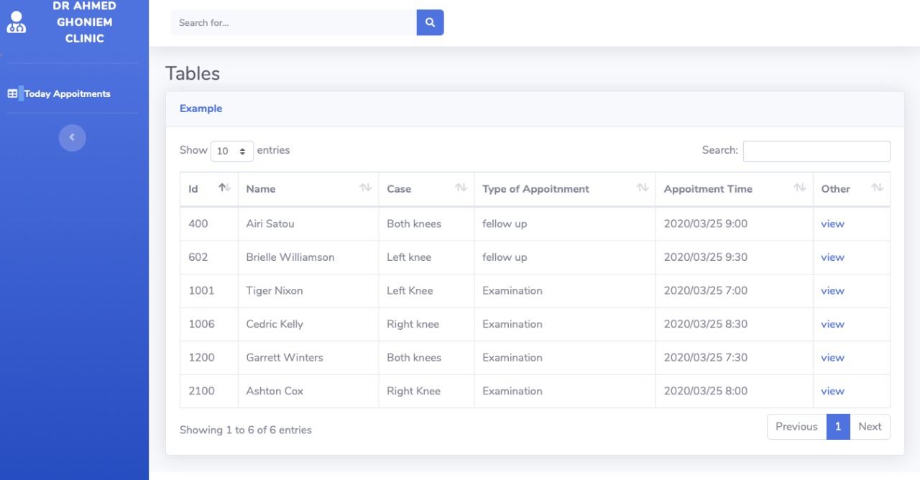
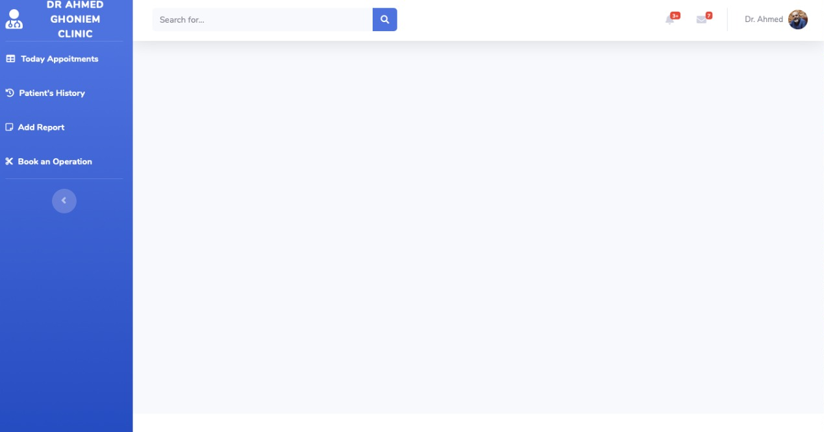
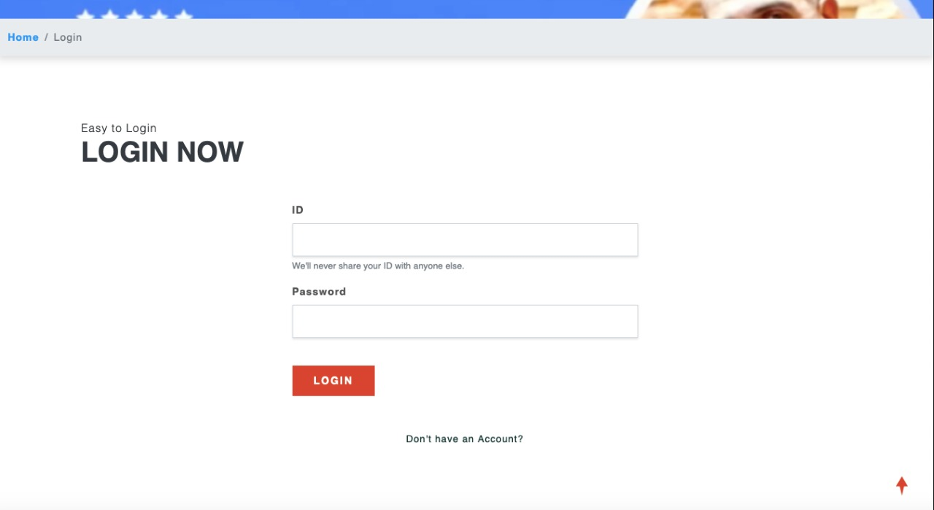
Screen Images
Admin’s Dashboard
Appointment's Time Table Page
Doctor's dashboard
Patient's login

Slide 31
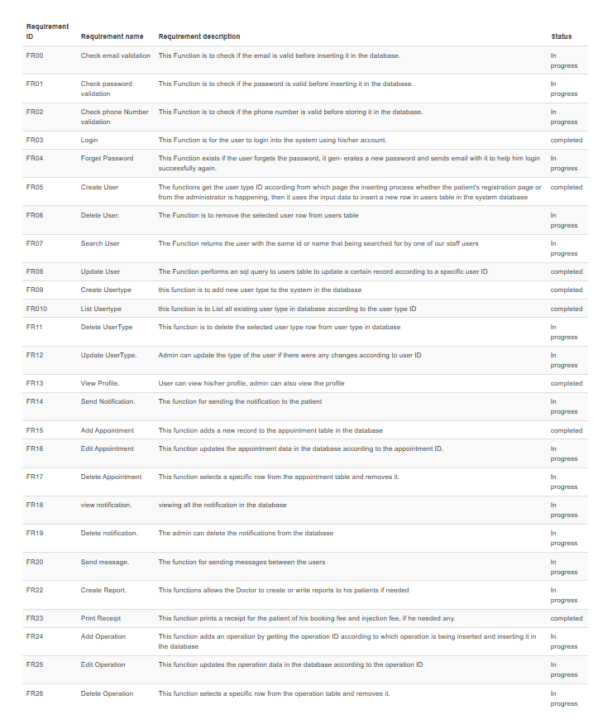
Requirements Matrix

Slide 32
References
[1] [Online] Ros, Fabian, "Hospital Management System using PHP with Source Code", 01 2018, SourceCode and Projects, Available at: https://code-projects.org/hospital-management-system-using-php-source-code/, Accessed:03/05/2020[2] [Online]CreatelyTemplates,"OnlineClinicReservationSystem-Con-textDiagram(DataFlowDiagrams(YC))",Creately,Availableat:https://creately.com/diagram/example/intvotax1/OnlineClinicReservationSystem-ContextDiagram,Accessed:10/05/2020

Slide 33
Thank You

